Slide 1
STUDENT MANAGEMENT SYSTEM

Slide 2
Objectives:
SIGN-IN and SIGN-OUT of the Student and Faculty Account
Updating the Attendance and Marks of respective Students through the Faculty Account
Displaying the Information regarding the Student Details like :
Name, Registration_No, Gmail_ID, Phone_No, Address, Course Fee-Details, Attendance, Marks.

Slide 3

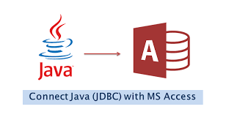

Software Required

Slide 4
Algorithm:
Sign-up if there is no account {Faculty or Student Login}
Enter all the Details like Name, Registration_No, Gmail_ID, Phone_No, Address, Course to Sign-up
Enter Registration-ID and Password {Faculty Login}
Enter the Attendance , Assignment, Marks
Sign-out {Faculty Login}
Enter Registration-ID and Password {Student Login}
View the details of the Student through Student account
View all details like Name, Registration_No, Gmail_ID, Phone_No, Address, Course , Fee-Details, Attendance, Marks
Sign-out {Student-Login}

Slide 5
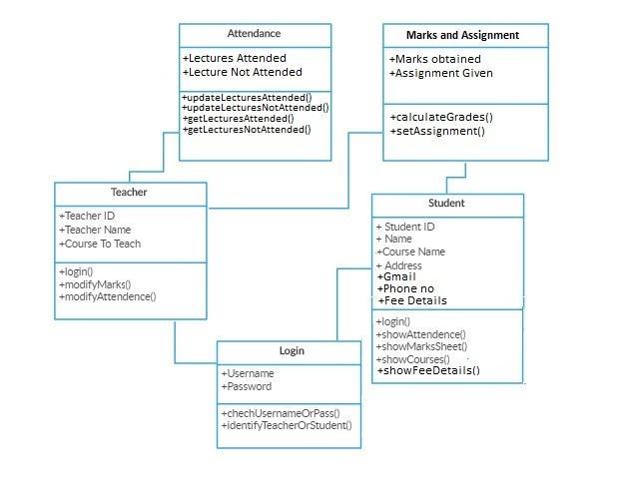
Class Diagram

Slide 6
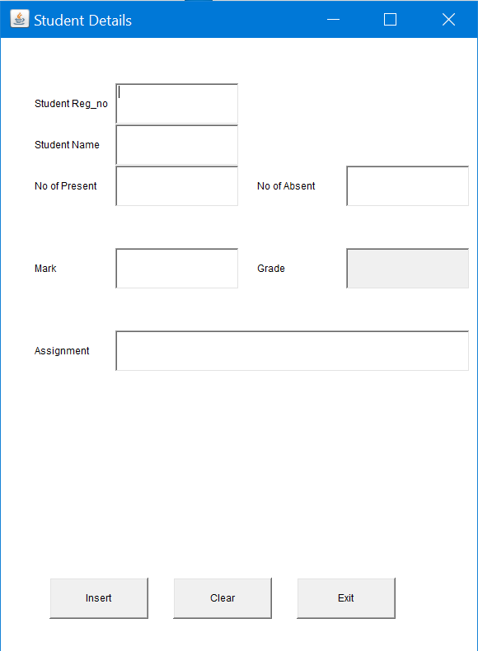
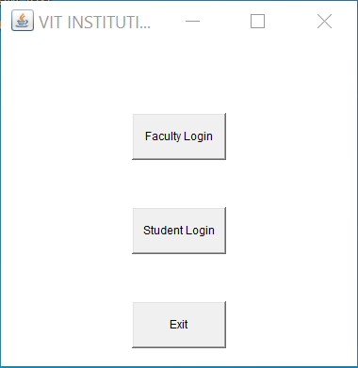
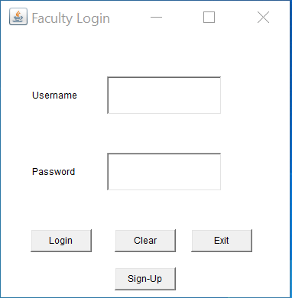
Miniature Model

